Slide 1
BE 490: Explorations in Cardiovascular Modeling
Preeya Khanna
Benjamin Shyong

Slide 2
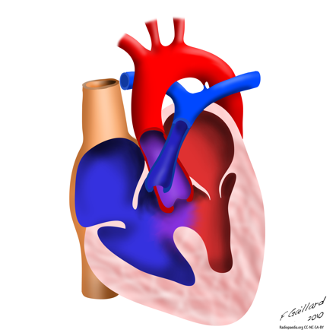
Problem: Post Surgical Tetrology of Fallot
One of the most common congenital heart defects (10% of cases)
Symptoms: Over-reaching aorta, Ventricular septal defect, Right ventricular outflow tract obstruction,Right Ventricular hypertrophy
Surgical Treatment corrects most symptoms
Post Surgical Problems:
Pulmonary Artery Stenosis
Pulmonary Valve Regurgitation

Slide 3
Objective/Design Goals
Develop a Lumped-Parameter model of the cardiovascular system that matches normal physiology
Adjust parameters in the pulmonary valve and artery to be able to match TOF patient with low error
Build a GUI that allows users of model to visualize relevant changes in physiology

Slide 4
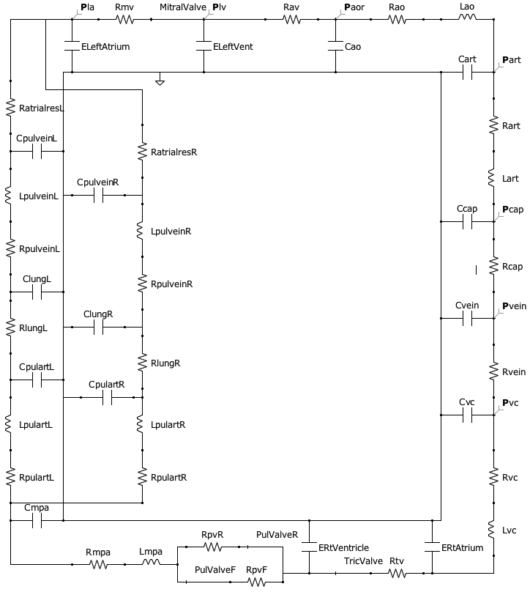
Developed Model:

Slide 5
Process of Model Development
Circuit Design
Start with Simple Model (Left Ventricle only)
Parameter Adjustment
Ensure model matches normal physiological measurements:
Compare Output to Real Data
Compare model of defect to clinical data of same defect
Estimate accuracy and predictive capabilities of the model
Increase Model complexity by adding more components, and making activation functions more complex
Total Systemic/Pulmonary Resistance
End Systolic/Diastolic Aortic Blood Pressures
Expected Pressure-Volume Curves in four heart chambers
Adjust parameters to account for physiological defects
Notes:
Circuit Development:
Simpler Models: Left Ventricle Only
Parameter Adjustment:
Ensure matching normal physiology
-Check clinical values:
-End diastolic and systolic blood pressure
-Total Systemic/Pulmonary Resistance

Slide 6
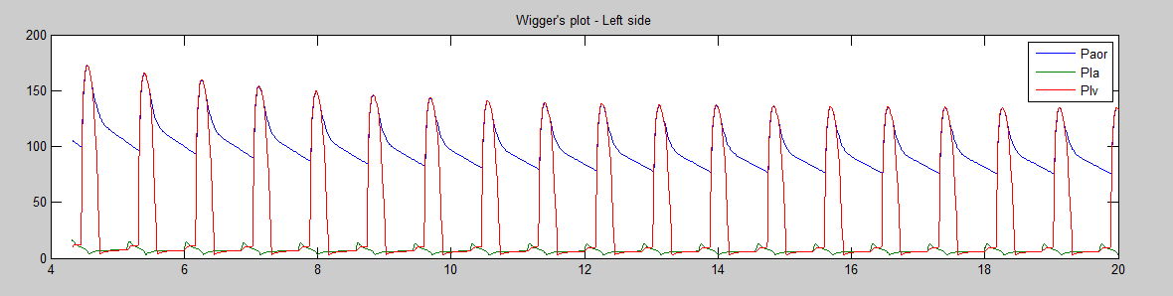
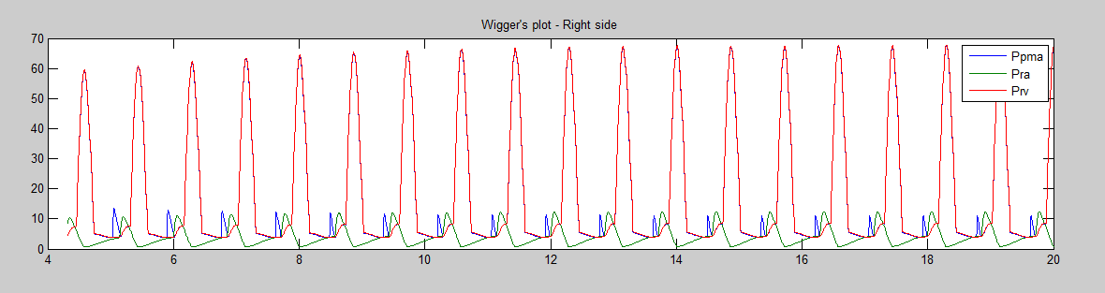
Diagrams
Pressures in Left Heart and Systemic System
Pressures in Right Heart and Pulmonary System

Slide 7
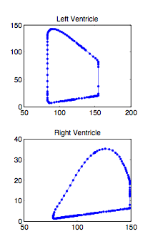
Pressure-Volume Curves
At left are the PV graphs for the left and right ventricles.
X-axis denotes volume in mL
Y-axis denotes pressure in mmHg
Maximum volume occurs at the end of diastole, when the ventricle is full. Maximum pressure occurs at the beginning of systole, when the ventricle undergoes contraction.

Slide 8
Actual Performance of Model
Error estimates of model in comparing results to clinical data

Slide 9
Conclusions/Recommendations
Overall, the model designed and implemented in this project showed satisfactory characterization of the cardiovascular system. This project can be extended by designing more granular control over model parameters, such as the excitation function for ventricular and atrial contraction.
We would like to acknowledge Dr. Raymond Watrous for advice and guidance in helping to design and develop the cardiovascular model.
References for clinical values:
Schlosser, Pagonidis, Herborn, et. al., Department of Diagnostic and Interventional Radiology, University Hospital Essen, Hufelandstrasse 55, 45122 Essen, Germany. “Assessment of Left Ventricular Parameters Using 16-MDCT: Results”. Am J Roentgenol. 2005;184(3):765-773.
Table 30-1 in: Trudie A Goers; Washington University School of Medicine Department of Surgery; Klingensmith, Mary E; Li Ern Chen; Sean C Glasgow (2008). The Washington manual of surgery. Philadelphia: Wolters Kluwer Health/Lippincott Williams & Wilkins. ISBN 0-7817-7447-0.
http://www.unc.edu/~rvp/old/RP_Anesthesia/Basics/Hemodyn.html. Ravindra Prasad, MD. The University of North Carolina at Chapel Hill. Assessed April 11, 2011.

